Slide 1
Yesterday’s posteriors and tomorrow’s priors: Adventures with Bayesian Analyses of Judgment and Decision Making
School of Psychology
Ben R. Newell
School of Psychology UNSW, Australia

Slide 2
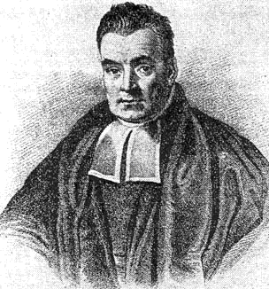
Three uses of Bayes…
Bayesian Models of Cognition (“Bayes in the Head”)
Bayesian Methods for Computational Model Comparison/Selection
Bayesian Statistical Methods for analyzing data.
revising our belief in the light of new evidence

Slide 3
Three case studies…
The role of “unconscious thought” in multi-attribute judgment
Priming “intelligence”
Exploring “base-rate” neglect

Slide 4
Unconscious Thought Theory (Dijksterhuis & Nordgren, 2006)
Complex thought best left to the unconscious
Deliberation-without-attention: a period of distraction leads to ‘better’ choices than a period of conscious deliberation (and ‘immediate’ choices)
Multi-attribute choice
    e.g., choose between 4 cars each described by 12 features or attributes
Controversial due to several failures to replicate…
Decision
Data Encoding
Mode of thought manipulation

Slide 5
“every experiment may be said to exist only in order to give the facts a chance of disproving the null hypothesis” (Fisher, 1935, p. 19).

Slide 6
Bayesian Analysis
Rather than ‘just’ failure to replicate, is there evidence for the null?
16 data sets (N>1000) from Newell (UNSW) and Rakow (Essex) labs across range of ‘unconscious thought’ experiments –
i.e., Evidence to support no difference between “conscious” and “unconscious” (distracted) thought

Slide 7
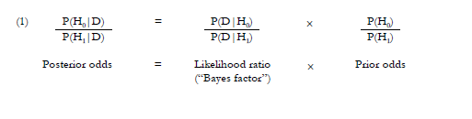
Prior odds – your belief in null (H0) or a specific alternate (H1) prior to seeing new data
Posterior – your belief in each given the data
Bayes Factor (LR) – the ratio of probabilities of the data given each hypothesis (an indication of how much to revise your belief)
Bayes Factor >1 indicates revision in favour of the null; <1 indicates revision in favour of the alternate
Notes:
Give example here with numbers

Slide 8
“Bayesian t-test”
Extend the approach to examine evidence for a distribution of alternate hypotheses
Use, e.g. A normal distribution of the effect size of H1
Then use Rouder et al. (2009) web-app to calculate the Bayes Factor*
* Requires as input standard t-value, and sample sizes (there are others – e.g. Dienes, 2012)

Slide 9
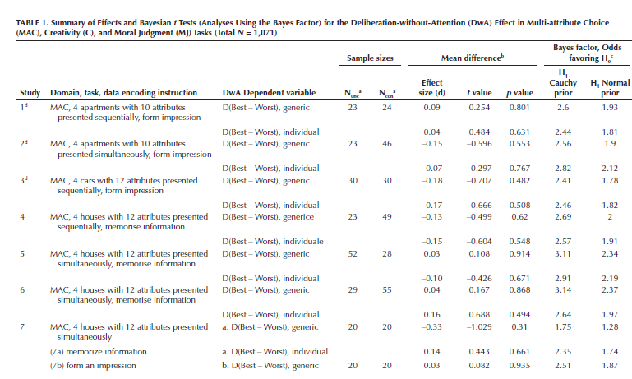
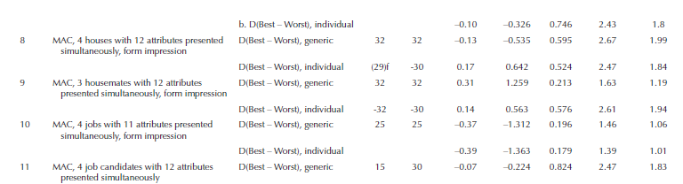

Slide 10
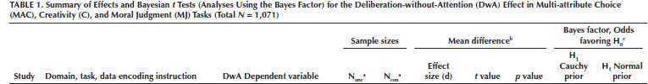

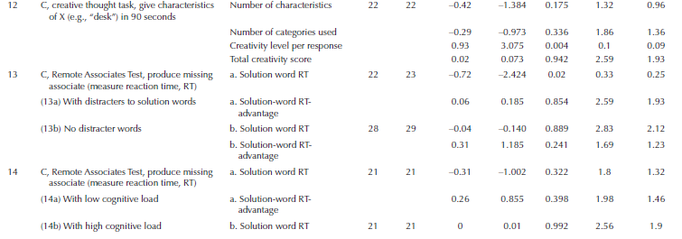
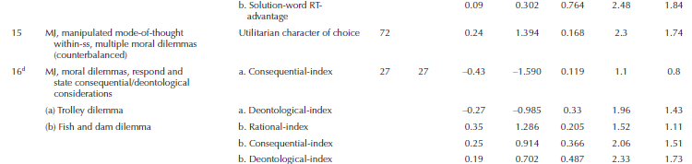
Bayes factor between
1:1 and 3:1 = ‘anecdotal’
3:1 to 10:1 = ‘substantial’,
10:1 to 30:1 = ‘strong’
Combined BF = 7 (Normal) or 9 (Cauchy)

Slide 11
What does a Bayes Factor of 7 mean?
For a “believer”
  Odds of 10:1 becomes 1.14:1 (v. slightly in favour of alternate)
For a “skeptic”
  Odds of 10:1 becomes 70:1 (strongly in favour of the null)

Slide 12
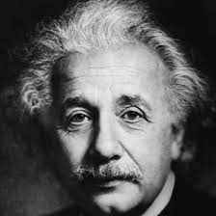
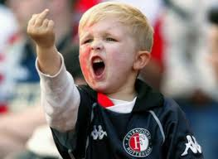
Case Study 2: Priming
‘‘Priming’’ refers to the passive, subtle, and unobtrusive activation of relevant mental representations by external, environmental stimuli, such that people are not and do not become aware of the influence exerted by those stimuli. In harmony with the situationist tradition, this priming research has shown that the mere, passive perception of environmental events directly triggers higher mental processes in the absence of any involvement by conscious, intentional processes…’’ (Bargh & Huang, 2009, p. 128)

Slide 13
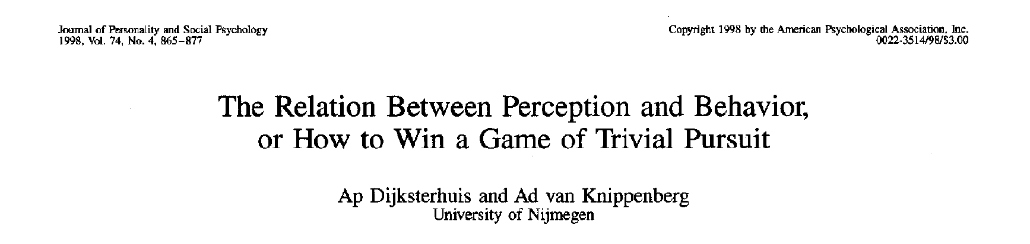
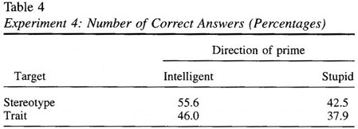


Priming intelligent behavior?
Phase 1: list the appearance, lifestyle, and behaviour of a typical professor/soccer hooligan
Phase 2: answer multiple-choice general knowledge questions
What is Europe’s longest river? Danube/Volga/Dnieper
Notes:
Comparison with the Mozart effect

Slide 14
Priming intelligent behavior?
Experiment 1: Raven’s matrices pre- and post-
video of professor/hooligans, then list attributes
Experiment 2: Raven’s matrices pre- and post-
list attributes
Experiment 3: general knowledge questions
list attributes
Experiment 4: general knowledge questions
list attributes
….and another 5 experiments.

Slide 15
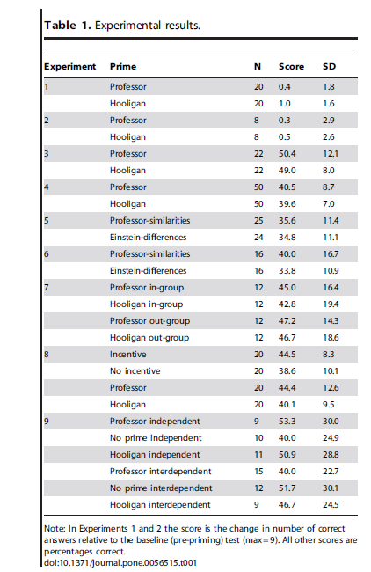
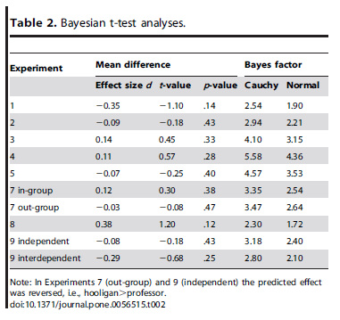
Combined BF=12.1 in favour of the null hypothesis

Slide 16
Evidence for the null is useful, but Bayesian methods offer much more…

Slide 17
Case Study 3: Base Rate Neglect: The Mammogram Problem
Doctors often encourage women at age 50 to participate in a routine mammography screening for breast cancer. From past statistics, the following is known:
1% of women had breast cancer at the time of the screening [Base rate]
Of those with breast cancer, 80% received a positive result on the mammogram [Hit rate]
Of those without breast cancer, 15% received a positive result on the mammogram [False positive rate]
All others received a negative result
Suppose a woman at age 50 gets a positive result during a routine mammogram screening. Without knowing any other symptoms, what are the chances she has breast cancer? __%
Eddy, (1982)

Slide 18
Some Data…
Notes:
Each ‘violin’ combines a boxplot and a kernel
density estimate. The boxplot component is indicated with the white circular symbol
(median), the inter-quartile range (heavy vertical line), and 1.5 × inter-quartile range (thin
vertical line) as an indicator of the range of scores. The ‘violin’-like shape of each
distribution is obtained through a smoothed density estimate of the data, rotated vertically,
and plotted on both sides of the box plot to create a symmetric figure. The width of the violin
is proportional to the number of data points that fall in that part of the distribution.

Slide 20
Low estimators

Slide 21
High estimators

Slide 22
In this context the mean is meaningless

Slide 23
Latent Mixture model
Assumes mixture of two populations of people
  Low and high estimators
  Low estimators closer to normative solution
Use the model to
Produce a posterior predictive distribution (what the model thinks should happen after ‘seeing’ the data)
Estimate the proportion of “low estimators” in the different experimental conditions (and thus how experimental manipulations affect these estimates)

Slide 24
Notes:
The model assumes that response Rij of participant i in condition j comes from one of
two normal distributions (truncated at 0 and 100, to respect the response scale given to
participants). The means of the normal distributions are μl and μh, the population mean of the
low-estimate and high-estimate distributions, respectively. The standard deviation of both
normal distributions is σ.1 Whether Rij is sampled from μl or μh is determined by zij, a
Bernoulli trial that takes the value of 0 or 1 on the basis of ϕj, the probability of an estimate
arising from the distribution of low estimators in condition j (the probability of an estimate
arising from the distribution of high estimators is 1–ϕj, by definition).

Slide 26
95% Highest density interval
Good!
Bad!
Notes:
The 95% highest density interval (Kruschke, 2011) – the smallest interval required
to contain 95% of the posterior density for a parameter.

Slide 27
BF₁₀ ≈ 10,000
Good!
Bad!

Slide 28
Conclusions
Bayesian Statistical Methods offer principled coherent ways to examine data
Provide evidence FOR the null – useful when controversy over replicability is an issue
Provides methods for dealing with data in which the mean does not capture anything meaningful
Allows us to update our beliefs in the light of data!

Slide 29

References & Acknowledgements
Case Study 1:
Newell, B.R., & Rakow, T. (2011). Revising beliefs about the merits of unconscious thought: Evidence in favor of the null hypothesis. Social Cognition, 29, 711-726
Case Study 2:
Shanks, D.R.,Newell,B.R., Lee, E.H., Balakrishnan, D., Ekelund, L., Cenac,Z. Kavvadia, F., and Moore, C.(2013).Priming Intelligent Behavior: An Elusive Phenomenon. PLoS One, 8(4): e56515
Case Study 3:
Hawkins, G., Hayes, B., Donkin, C., Pasqualino, M., & Newell, B. R. (accepted, pending minor revisions). A Bayesian latent mixture model analysis shows that informative samples reduce base rate neglect. Decision.

Slide 30
50% Low estimators
50% High estimators

Slide 31
80% Low estimators
20% High estimators

